Slide 1
The Dilemma of High Availability
Date
Presenters:
Copyright © 2022 SIOS Technology Corp. All rights reserved.

Slide 2
High availability of applications and databases
is critical for many organizations
Notes:
As we all know, more and more essential business operations - from payroll to production scheduling to marketing and finance, relay on applications, databases, and ERP systems.

Slide 3
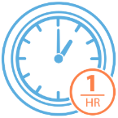
Downtime is expensive
1HR
$300K
1HR
$1- 4M
of downtime
lost business, productivity disruptions and remediation efforts
of downtime
lost business, productivity disruptions and remediation efforts
91%
44%
of organizations
of organizations
Data courtesy of ITIC 2021Global Server Hardware, Server OS Reliability Survey
Notes:
Downtime is expensive. When these systems go offline it can cost companies a fortune. According to a survey by the Information Technology Industry Council, an hour of downtime cost more than $300K in lost business, productivity disruptions, and the work IT needed to do to get their systems back up and running. Of that group, 44% said an hour of downtime cost $1-4 million dollars.

Slide 4
and affects many industries

Slide 5
But downtime costs more than just $$$

Slide 6
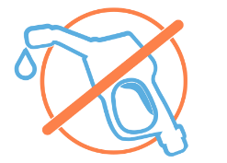
If supply chains fail
If FinServ systems fail
If Healthcare systems fail
Supermarket shelves are empty
Gas stations run dry
Deliveries are not made
ATMs won't dispense cash
Online purchasing is not possible
Stock markets react impacting portfolios, pensions, and more
People miss appointments and operations
Patient are put at risk
People die
Notes:
https://www.healthcareitnews.com/news/ehr-outage-takes-down-federal-cerner-systems
https://www.abc.net.au/news/2022-06-27/flu-cases-and-covid-increase-pressure-on-nt-health-system/101176238
https://www.nextgov.com/it-modernization/2022/04/va-dod-electronic-health-record-system-suffers-nationwide-outage/364164/

Slide 7
Uptime Goals
89% of organizations now require a minimum of four nines or 99.99% availability.
99%
Data courtesy of ITIC 2021Global Server Hardware, Server OS Reliability Survey
Notes:
That’s why 99.99% or four nines of availability for essential applications is now a must-have for the vast majority of companies.

Slide 8
Ensuring the High Availability of systems is complicated
Notes:
But High Availability isn’t easy. In fact, it’s quite complicated. To keep an application running, everything that application depends on has to be operational – the network, storage, hardware, middleware, operating system, and the application itself. If you are running a complex ERP system with multiple supporting services and interdependent components, it’s even more complicated.

Slide 9
Some OS Vendors Offer HA
Notes:
There are several ways to deliver HA. Some OS vendors, such as Microsoft Windows, SUSE Linux, and Red Hat Linux provide HA clustering software.

Slide 10
But HA offered by Linux vendors is....
Complex &
manual
Notoriously unreliable & unstable
Costly & time consuming to keep up with changes
Notes:
But those do little to simplify the complexity.

Slide 11
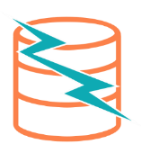
And Windows HA…
May require costly application upgrades
May limit disaster recovery protection

Slide 12
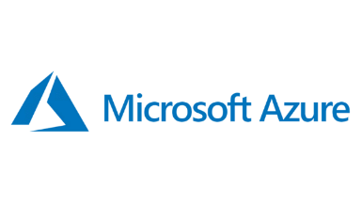
Clouds Offer HA SLAs
99.94% Server Uptime
Managed Services
Notes:
Clouds offer Service Level agreements guaranteeing high availability for their infrastructures.

Slide 13
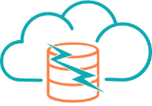
But Cloud SLAs
Don't protect against software failures
Don’t enable DR protection across cloud availability zones and regions
Notes:
But they don’t protect you from a wide range of downtime threats – from software compatibility errors, human error, and many more.

Slide 14
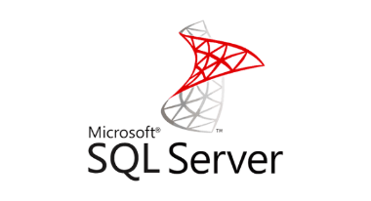
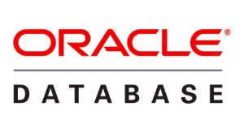
Applications Add More Complexity
Essential applications - SAP, HANA, Oracle and SQL Server to run their operations.
Notes:
Applications, Databases and ERPS themselves each have their own requirements

Slide 15
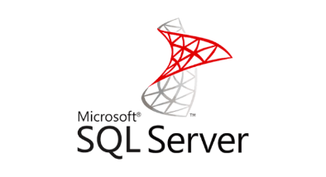
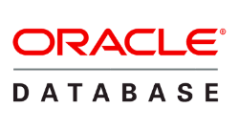
Every Application is Different
Specific configurations, boot orders, and settings that need to be applied for them to operate successfully
Require HA expertise to ensure reliable protection

Slide 16
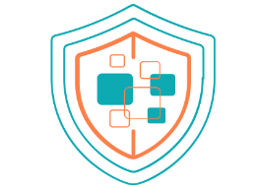
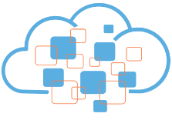
High Availability Presents a Dilemma
We need to ensure high availability
But the environments we want to protect are incredibly complex
And while the cloud seems like the perfect solution, it just adds even more complexity.

Slide 17
SIOS Solutions

Slide 18
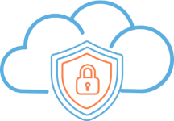
SIOS Solutions
Protect essential business applications & databases
Remove the complexity of High Availability and Disaster Recovery
Enable the power of the cloud without the risks

Slide 19
The SIOS approach
SIOS orchestrates the seamless transition of application operation to secondary or remote systems in the case of hardware failure, power loss, or other unforeseen circumstances.

Slide 20
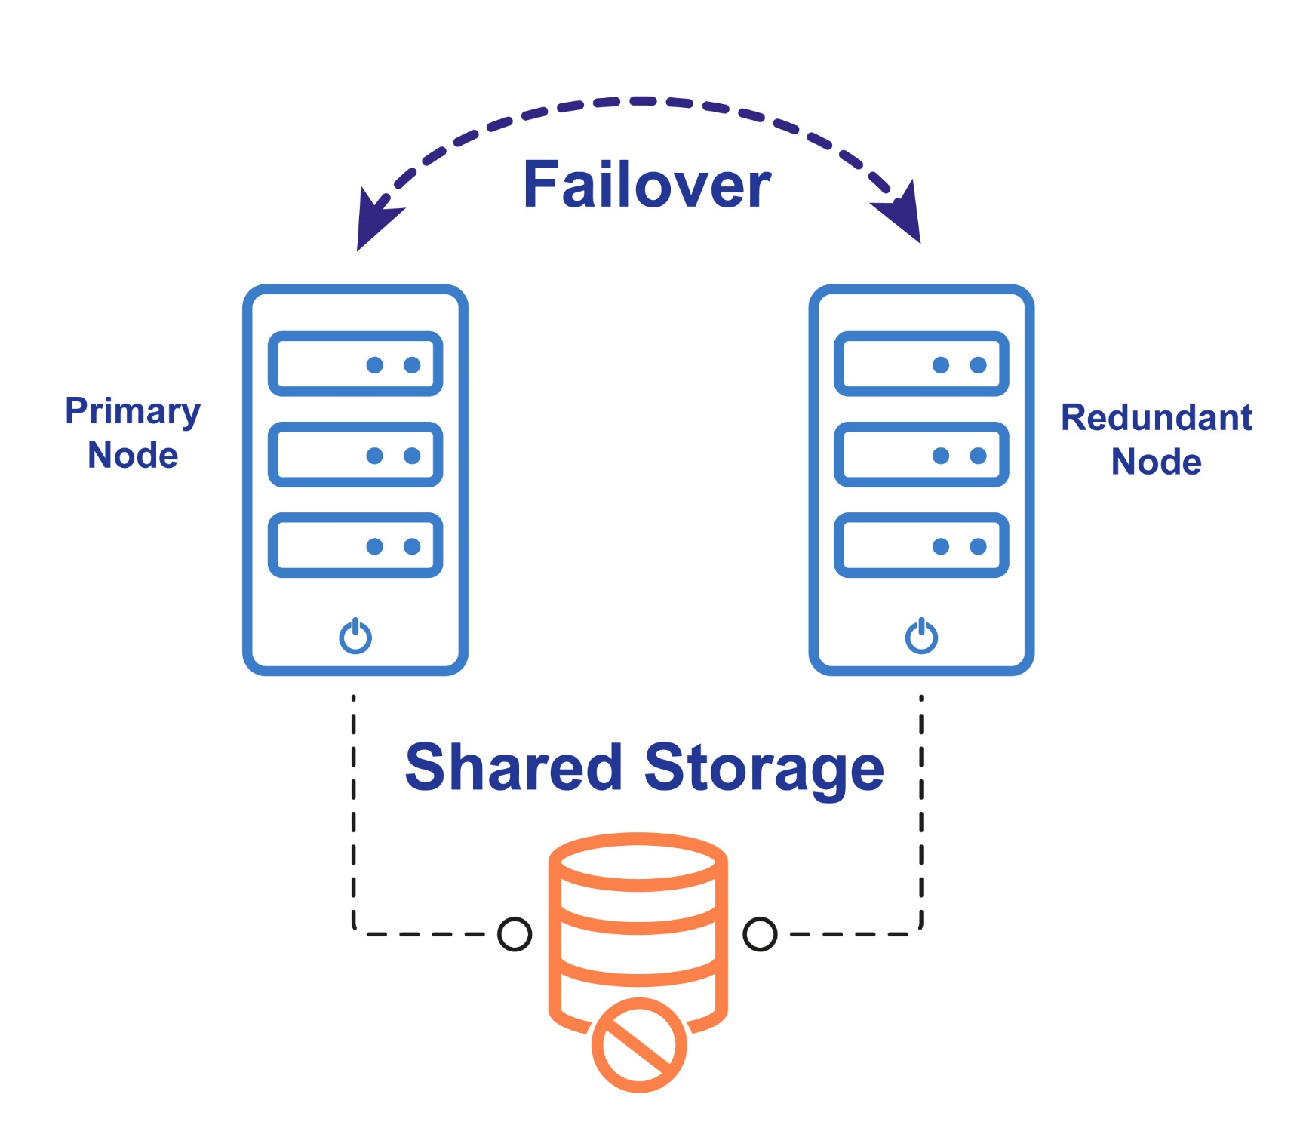
Typical High
Availability Clustering
Redundant server nodes ready in case of failure
Shared storage - for low RPO
Generic failover process

Slide 21
Typical High Availability Clustering
But share storage. . .
Has a single point of failure
Not available in some clouds, costly and complex in others
And every application is different

Slide 22
SIOS Simplifies Cluster Complexity
Reliable
Application-aware failover
Flexible
Synchronized local storage or traditional shared storage
On premises, cloud, hybrid cloud
Deep Expertise
End-to-end guidance and support

Slide 23
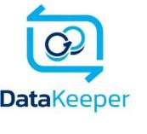
Add Flexibility to Windows Server Failover Clustering
DataKeeper Cluster Edition
Delivers advanced cluster protection for 70% less cost
Eliminates costly upgrades to SQL Server or Oracle
Enterprise Edition just for HA
Widest support for SQL Server versions
Enables WSFC in Cloud without Complex Shared Storage
Block-level data replication
Clustering without shared storage
Synchronous or asynchronous modes
Works across cloud-regions and availability zones

Slide 24
Simplifying Linux
Clustering
Out of the box stability and tuning
Installs in less than 1 hour - 5x faster than SUSE HAE
Reduces maintenance and failover testing by up to 3 days
per cluster
per year
LifeKeeper
High-availability failover clustering
Single - or multi-site configs
Any backend storage
Automatic or push-button failover

Slide 25
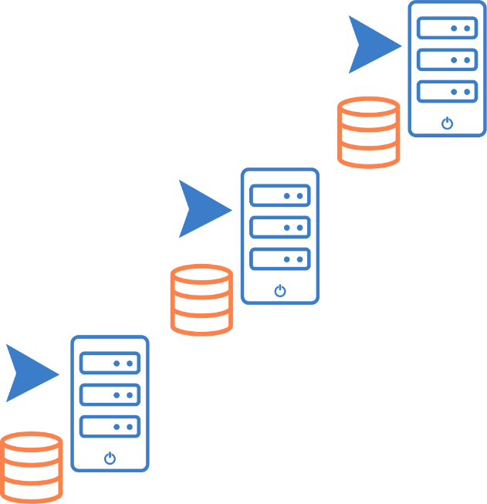
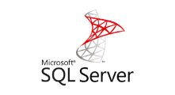
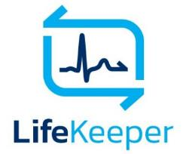
Unparalleled Reliability
SIOS LifeKeeper Clustering Software Includes Application-specific Recovery Kits (ARKs)
Wizard-driven configuration for 5X faster deployment than open source clusters
Input validation for configuration accuracy
Application-awareness ensures application best practices are maintained for reliable HA

Slide 26
Unique Application Recovery Kits
Services
Applications
Apache
Samba
NFS
LVM
SW Raid (md)
SAP
WebSphere MQ
Any Custom App
Databases
Storage
Oracle
MySQL
PostgreSQL
DB2
SAP
Skybase
MaxDB
Data Replication
Hitachi HDLM
EMC PowerPath
DMMP
NAS
IBM SDD
Notes:
SIOS application recovery kits provide application-specific intelligence – automating configuration, providing advanced monitoring of the entire application stack, and orchestrating failover in compliance with application specific best practices.

Slide 27
SIOS Protection Suite
DataKeeper
LifeKeeper
Block-level data replication
Clustering without shared storage
Synchronous or asynchronous modes
Works across cloud-regions & availability zones
High-availability failover clustering
Single- or multi-site configurations
Any backend storage
Automatic or push-button failover

Slide 28
SIOS Protection Suite
Application Recovery Kits
provide predefined configuration
for rapid deployment and complete protection
DataKeeper
LifeKeeper
Block-level data replication
Clustering without shared storage
Synchronous or asynchronous modes
Works across cloud-regions & availability zones
High-availability failover clustering
Single- or multi-site configurations
Any backend storage
Automatic or push-button failover

Slide 29
Single Solution
SIOS provides a consistent and complete clustering and failover solution to enable high availability and disaster protection for Essential Applications and Databases across on-premises, cloud, and hybrid environments

Slide 30
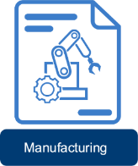
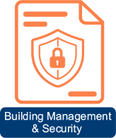
SIOS Use Cases

Slide 31
HA for SAP on Azure
The Environment
Moving all Windows systems to server 2019
Expanding SAP infrastructure with SAP HANA
The Challenge
Required cost-effective SAP-Certified HA solution
Ensure High Availability Solution in Azure is as robust as their on-premises infrastructure
The Solution
SIOS DataKeeper Cluster Edition software to WSFC to build 2-node failover clusters Azure
The Results
Fast, Efficient Implementation
SAP Azure environment needed to expand by an additional 25 Clusters / 50 SIOS DKCE licenses
Robust, SAP-Certified High Availability Protection

Slide 32
HA for SAP on AWS
The Environment
50 complex SAP workloads, over 200 Servers
Had on-premises SAP Linux
Migrating to SAP ERP SUSE SLES Linux on AWS
The Challenge
Required cost-effective SAP-Certified HA solution
Ensure HA in AWS is as robust as on-premises infrastructure
Short timeframe for migration
The Solution
SIOS Protection Suite in AWS on SAP Linux Enterprise
The Results
Fast, Efficient Implementation
Significant overall cost reduction
Configuration Wizards met short timeframe requirement
Robust, SAP-Certified High Availability Protection

Slide 33
HA for SAP on Oracle
The Environment
30+ SAP Systems
End of support hardware environment
On-premise SAP on AIX + Oracle
Migrating to Red Hat Enterprise Linux (RHEL)
Adaptive Server Enterprise (ASE) on AWS
The Challenge
SAP-Certified HA solution required
Ensure HA in AWS is as robust as on-premises infrastructure
The Solution
SIOS DataKeeper for SANless Clusters in AWS on Red Hat Linux Enterprise
The Results
Fast, Efficient Implementation using configuration Wizards
Robust, SAP-Certified High Availability Protection

Slide 34
Enabling the World’s Largest SAP Deployment in Azure
The Environment
Largest SAP deployments in Azure worldwide
32+ nodes running large MS SQL server databases
The Challenge
Bit Level replication to DR site flooding bandwidth and reducing reliability
Needed reliable, efficient High Availability solution for Improved (RPO/RTO)
Existing replication software had minimal features for bandwidth throttling etc.
The Solution
SIOS DataKeeper enabled the use of MS Windows Failover Clustering without a SAN
The Results
Delivered HA and DR protection of critical SAP Central Services servers across MS Azure Fault Domains

Slide 35
Who Is SIOS?

Slide 36
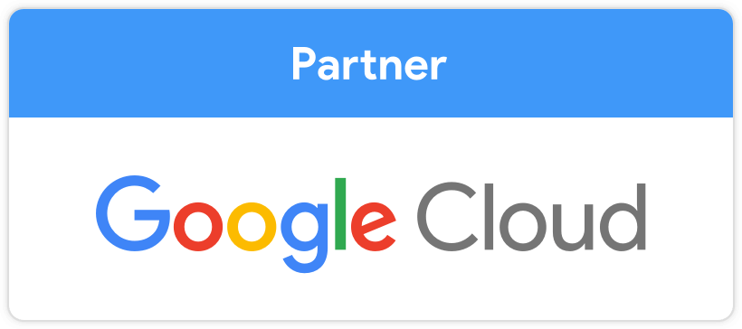
SIOS Technology Corp.
Founded in 1999
Headquarters in San Mateo, CA
Offices in
Across US
United Kingdom
Germany
Singapore
Japan
2021 Cloud Computing Product of the Year

Slide 37
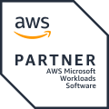
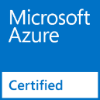
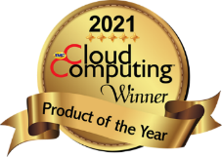
Leading Experts in High Availability and Disaster Recovery
20+ Years focused on HA/DR
80,000+ licenses installed globally
Microsoft Partner Since 2007
Microsoft Azure Certified
Offerings in Azure Marketplace
AWS Partner Since 2014
ISV-Accelerate
Strategic AWS Microsoft Workload Competency Partner
Offerings in AWS Marketplace
SAP-Certified
SIOS Protection Suite for NetWeaver HA and S4/HANA HA

Slide 38
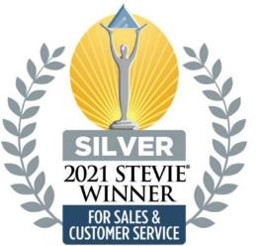
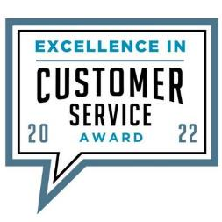
Award-winning Customer Service and Support
2022 Gold Stevie® Award - Customer Service Team of the Year
2022 Cloud Computing Excellence in Customer Service Award
2021 Silver Stevie® International Business Award - Customer Service Department of the Year
Support and R&D Engineers in Columbia, SC
Average 7 Years HA Support with SIOS
Cloud Certification, Stringent, Ongoing Training
24/7/365 Emergency Coverage Worldwide

Slide 39
Expert Professional Services
Services Packages to Meet Your Needs
Configuration and Setup Assistance
HA Health Checks and Best Practices
Run Book Development and Management
Custom Programs
Trained, Certified HA/DR Specialists

Slide 40
End-to-End Expert Support
Professional Services Team
POC Planning
POC Setup and Testing
Custom Services
Installation Services
Health Checks
Training
Installation,
Troubleshooting
Custom Services
Choose the right product
POC and Test
Configure and Go Live
and Maintain Reliable Protection
Customer Success Team
Support Team
Product Recommendations
Sample Test Plans, Imp. Guides
High Level Q&A,
Go Life Checklist
Technical Support (TSA)
Notes:
SIOS supports customers from the beginning of their buying journey, through their testing and deployment and throughout their ongoing maintenance with unparalleled HA expertise and commitment to excellence.

Slide 41
SIOS Use Cases

Slide 43
Microsoft Partnership
Strategic Partnership since 2007
Silver Application Development
Marketplace, AMI for Windows
Bring Your Own License and Pay-as-You-Go
Azure Stack Market Place (BYOL) Windows
Certified across multiple applications and OS
SAP, Oracle, SQL, Windows, Linux, etc.
100+ Joint Customers Marquee Accounts
Rio Tinto, Mosaic, National Life Group, Atento, John Hancock Insurance, Mars, Arthex, Acco Brands, Zespri. (edited)

Slide 44
Azure Partnership
AWS Partner Since 2014
Differentiated Software Partner
Strategic AWS Microsoft Workload Competency Partner
ISV-Accelerate
Quickstarts and Offerings in AWS Marketplace
Hundreds of Joint Customers
NFL, Delmonte, Bose, Dept. of Justice, ESPN, Thermo-Fisher

