Slide 1
Protecting Essential ERPs, Databases, and Applications
Month xx, 2024
Presenter:
Copyright © 2022 SIOS Technology Corp. All rights reserved.

Slide 2
SIOS Overview
SIOS DataKeeper Cluster Edition
Replication to Enhance Windows Server Failover Clustering (WSFC)
SIOS LifeKeeper for Linux
Enterprise-Ready Linux Clustering
SAN & SANless Clusters for Physical, Virtual, and Cloud Environments
Notes:
SIOS provides high availability clustering for Windows and Linux environments. Today, I’ll tell you about two main products – SIOS DataKeeper Cluster Edition – which you can use with Windows Server Failover Clustering to protect SQL Server and other essential Windows applications – and SIOS LifeKeeper for LInux which provides complete, end-to-end clustering for Linux workloads, such as SAP, HANA, Oracle, and MaxDB.

Slide 3
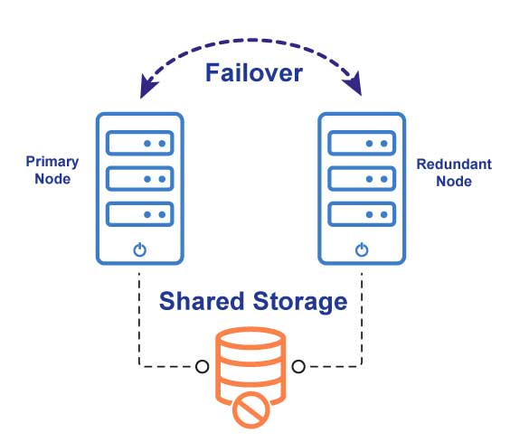
SIOS Simplifies Cluster Complexity
Reliable
Application-aware failover
Flexible
Synchronized local storage or traditional shared storage
On premises, cloud, hybrid cloud
Deep Expertise
End-to-end guidance and support
Notes:
SIOS is designed to simplify cluster complexity. In a traditional clustering environment, the application is run on a primary node, clustering software detects a failure, it orchestrates failover to a redundant node. Since both nodes are connected to shared storage, the application or database can continue to operate with RPO of zero. You can use SIOS software in this configuration or you can eliminate shared storage altogether by connecting both nodes to locally attached storage. In a Windows environment, you can configure your cluster this way and pair Windows Server Failover Clustering with SIOS DataKeeper replication. WSFC will handle the monitoring and failover orchestration. SIO DataKeeper uses block level host-based storage to replicate all writes to the primary node storage over to the redundant node storage – keeping them synchronized.
In a Linux environment, our LifeKeeper software takes the place of WSFC – handing the monitoring and failover orchestration. It can be paired with DataKeeper for replication or used with HANA HSR or other replication if needed.

Slide 4
Add Flexibility to Windows Server Failover Clustering
DataKeeper Cluster Edition
Delivers advanced cluster protection for 70% less cost
Eliminates costly upgrades to SQL Server or Oracle Enterprise Edition just for HA
Widest support for SQL Server versions
Enables WSFC in Cloud without Complex Shared Storage
Block-level data replication
Clustering without shared storage
Synchronous or asynchronous modes
Works across cloud-regions and availability zones

Slide 5
Simplifying Linux
Clustering
Out of the box stability and tuning
Installs in less than 1 hour – 5x faster than SUSE HAE
Reduces maintenance and failover testing by up to 3 days
per cluster
per year
LifeKeeper
High-availability failover clustering
Single - or multi-site configs
Any backend storage
Automatic or push-button failover

Slide 6
SIOS Protection Suite
DataKeeper
LifeKeeper
Block-level data replication
Clustering without shared storage
Synchronous or asynchronous modes
Works across cloud-regions & availability zones
High-availability failover clustering
Single- or multi-site configurations
Any backend storage
Automatic or push-button failover
Notes:
We sell SIOS LifeKeeper in a Suite called the SIOS Protection Suite. It comes with LifeKeeper plus DataKeeper Replication and a collection of application recovery kits.

Slide 7
SIOS Protection Suite
Application Recovery Kits
provide predefined configuration
for rapid deployment and complete protection
DataKeeper
LifeKeeper
Block-level data replication
Clustering without shared storage
Synchronous or asynchronous modes
Works across cloud-regions & availability zones
High-availability failover clustering
Single- or multi-site configurations
Any backend storage
Automatic or push-button failover

Slide 8
Application Recovery Kits
Services
Applications
Apache
Samba
NFS
LVM
SW Raid (md)
SAP
WebSphere MQ
Any Custom App
Databases
Storage
Oracle
MySQL
PostgreSQL
DB2
SAP
Skybase
MaxDB
Data Replication
Hitachi HDLM
EMC PowerPath
DMMP
NAS
IBM SDD

Slide 9
LifeKeeper Architecture
LifeKeeper Node
Application Recovery Kit
Recovery Direction
Recovery Actions
Alarm API
Recovery API
Configuration API
Communication API
LifeKeeper Core
Configuration
Database
Communications Manager
Administration & Status Display
to LifeKeeper CM on another node
Notes:
Detailed discussion in Architecture module.
LifeKeeper Configuration Database:
Stores individual resource configuration data
Stores recovery information for resource types
Stores status information for resource instances
Maintains domain objects (system, network, resource, dependency, equivalency, etc.)
LifeKeeper Communications Manager:
Provides messaging services between components
Provides failure detection services
LifeKeeper Administration GUI:
Cluster formation
Node properties
Automatic switchover and failover settings
Resource configuration and properties
Resource hierarchy management
Visual status of both servers and resources
Application Recovery Kits:
Actions for resource protection and recovery
Resource monitoring
Failover instruction
lkcheck Daemon:
checks the health and status of LifeKeeper-protected resources
periodically calls the quickCheck script for each resource
quickCheck provides a quick health check of the resource
if resource is in a failed state, quickCheck calls the event notification mechanism (sendevent) via the Alarm APIs
Alarm APIs initiates recovery via the Recovery APIs (recover)
Alarm API:
sendevent is the sockets-based alarming mechanism
sendevent communicates with the LCD to determine if there are recovery scripts available. If so, it calls the Recovery API (recover)
Recovery API:
The recover process runs the recovery script associated with the resource.

Slide 10
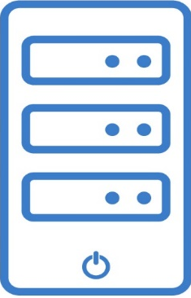
High Availability SAP
Client
Ensure performance is not restricted by resource allocation constraints
Application Servers
SAP Central Services
ASCS/SCS/PAS/ERS
Replication
Replication
3 Node Configuration to Manage
Regional Disasters
Database
Servers
Replication
Replication
2nd Region
DR Site

Slide 11
SIOS Components
Web-enabled layer
Web browser logic
Gateway
Protected Components and Corresponding ARKs
SAP ARK
IP ARK
Storage ARK (for Data Replication)
NAS ARK
EC2 ARK
Generic Application ARK
Presentation layer
SAP HRM (HR Management)
SAP MM (Material Management)
SAP SD (Sales & Distribution)
SAP PS (Project System)
SAP Apache Content Management
Etc
…
Sybase ARK
Oracle ARK
DB2 ARK
HANA ARK
SAP MaxDB ARK (SAP DB)
IP ARK
Application layer
SAP Process Orchestration
SAP Identity Management
SAP Business Warehouse
File System (NFS or replicated or shared)
Central Services
Message Service
Message Service
Enqueue Service
Enqueue
Service
Data layer
NFS ARK
IP ARK
Data Replication ARK
NAS ARK
Sybase
Oracle
DB2
HANA
SAP DB
File System (Replicated or Shared)

Slide 12
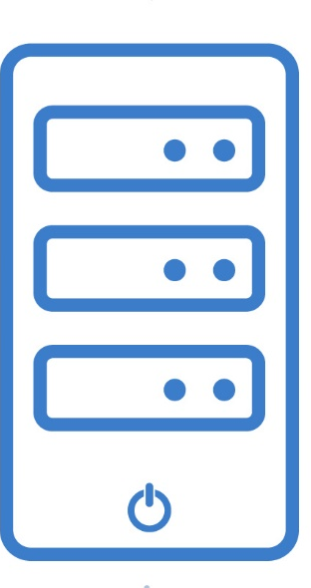
Automatically Maintains SAP Best Practices
Protection for key SAP components:
Primary Application Server (PAS)
ABAP SAP Central Service (ASCS)
SAP Central Services (SCS)
Enqueue and message servers
Enqueue Replication Server (ERS)
Database (Oracle, Sybase, MaxDB, HANA, etc.)
Shared and/or Replicated File Systems
Logical Volumes (LVM)
NFS Mounts and Exports
Virtual IPs
Failover
CI
CI
AS
Replication
State: Active
State: Stand-by
SCS
SAP Central Server Services
Database
CI
AS
SAP Central Instance
Application Server
Notes:
Verifies that SAP is running, file shares or NFS exports are available, databases are mounted and available, and clients are able to connect.

Slide 13
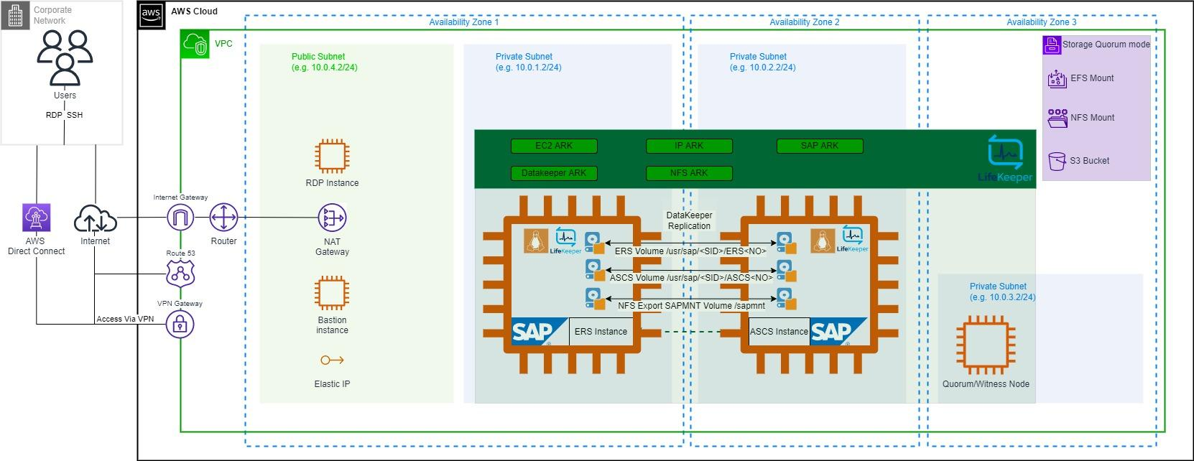
Cluster Layout in AWS

Slide 14
HANA 2.0 “Takeover with Handshake” (Suspend Primary)
No waiting for primary database to stop → Reduced downtime
Traditional HSR Takeover
Stop primary database (slow)
Perform HSR takeover on backup system to register backup database as primary
Register previous primary database instance as new secondary
Start new secondary database
Takeover with Handshake
Suspend primary database (quicker)
Perform HSR takeover on backup system to register backup database as primary
Stop previous primary database (slow)
Register previous primary database as new secondary
Start new secondary database
Clients can access primary database

Slide 15
SAP Recovery Kit
Out-of-the-Box, SAP-Certified High Availability for SAP Environments
Intelligent, application-aware failover orchestration
Protection for (A)SCS, ERS, and PAS instances
Maintains SAP Best Practices Throughout Recovery and Failover
Monitoring and recovery of all necessary instance processes as well as supporting processes (e.g., SAP Host Agent, SAP OS Collector, SAP Start Service)
Verifies that necessary NFS exports are available and mounted before performing administrative operations
Maintains cross-node lock table redundancy by running (A)SCS and ERS instances on different cluster nodes when possible

Slide 16
SAP HANA Recovery Kit
Out-of-the-Box High Availability for SAP HANA Environments
Intelligent, application-aware failover orchestration
Protects SAP HANA scale-up clusters utilizing HANA System Replication (HSR)
Maintains SAP Best Practices Throughout Recovery and Failover
Monitors and recovers all necessary instance and supporting processes (e.g., SAP Host Agent, SAP OS Collector, SAP Start Service)
Monitors HANA System Replication status to prevent accidental data loss due to HSR takeover while replication is out-of-sync
Maintains a “hot standby” running secondary database for quick switchover and failover
Near-zero downtime for switchovers during planned maintenance
Supports “Takeover with Handshake” with HANA 2.0 SPS04 and later

Slide 17
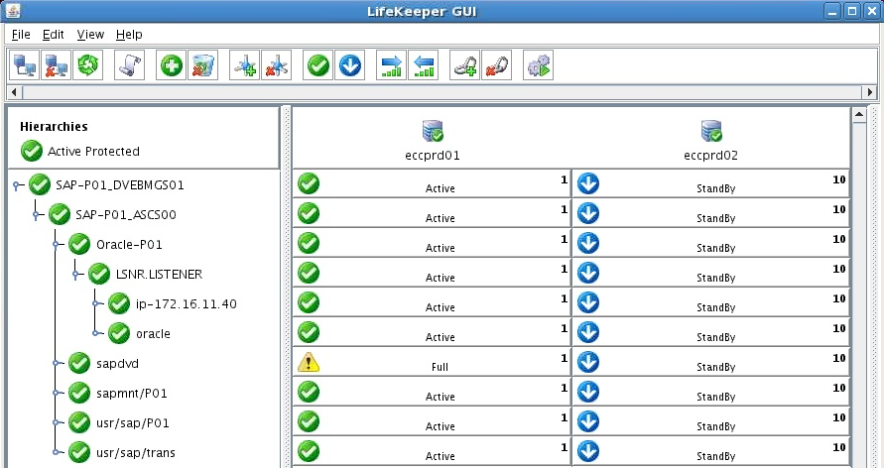
Easy to Deploy and Use
Simple User Interface
Monitor and Administer your clusters via a single, intuitive interface
Accessible via a web browser, or native X11 Linux application
Command Line Interface (CLI)
Hierarchy
Dependencies
Notes:
Simplicity in the GUI, dependencies, resources, active node, standby, talk failover.
GUI via X11/VNC, and CLI (common for day to day ops)

Slide 18
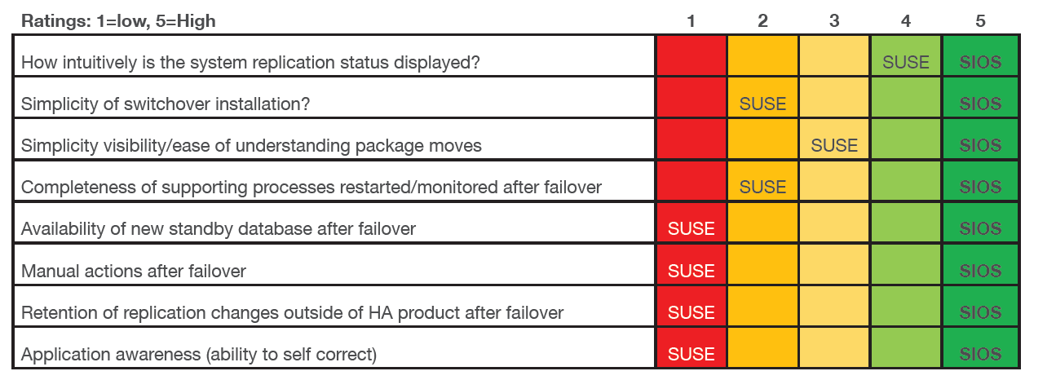
LifeKeeper is Faster, Easier, More Reliable

Slide 19
Award-winning Customer Service and Support
2022 Gold Stevie® Award - Customer Service Team of the Year
2022 Cloud Computing Excellence in Customer Service Award
2021 Silver Stevie® International Business Award - Customer Service Department of the Year
Support and R&D Engineers in Columbia, SC
Average 7 Years HA Support with SIOS
Cloud Certification, Stringent, Ongoing Training
24/7/365 Emergency Coverage Worldwide

Slide 20
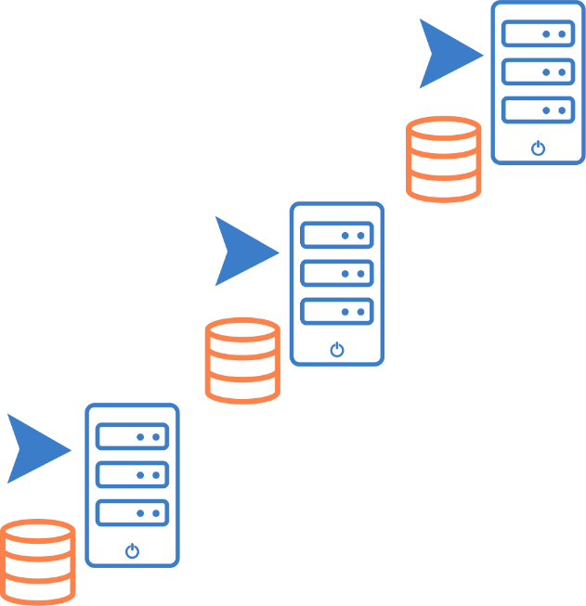
Unparalleled Reliability
SIOS LifeKeeper Clustering Software Includes Application-specific Recovery Kits (ARKs)
Wizard-driven configuration for 5X faster deployment than open source clusters
Input validation for configuration accuracy
Application-awareness ensures application best practices are maintained for reliable HA

Slide 21
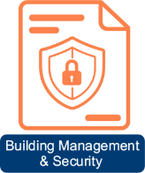
SIOS Use Cases

Slide 22
HA for SAP on AWS
The Environment
50 complex SAP workloads, 200+ servers
Had on-premises SAP Linux
Migrating to SAP ERP SUSE Enterprise Linux on AWS
The Challenge
Required cost-effective SAP-Certified HA solution
Ensure HA in AWS is as robust as on-premises infrastructure
Short timeframe for migration
The Solution
SIOS Protection Suite in AWS on SAP Linux Enterprise
The Results
Fast, Efficient Implementation
Significant overall cost reduction
Configuration wizards met short timeframe requirement
Robust, SAP-Certified High Availability Protection

Slide 23
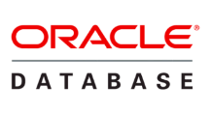
HA for SAP on Oracle
The Environment
30+ SAP Systems
End of support hardware environment
On-premise SAP on AIX + Oracle
Migrating to Red Hat Enterprise Linux (RHEL)
Adaptive Server Enterprise (ASE) on AWS
The Challenge
SAP-Certified HA solution required
Ensure HA in AWS is as robust as on-premises infrastructure
The Solution
SIOS DataKeeper for SANless Clusters in AWS on Red Hat Linux Enterprise
The Results
Fast, Efficient Implementation using configuration Wizards
Robust, SAP-Certified High Availability Protection

Slide 24
Who Is SIOS?

Slide 25
SIOS Technology Corp.
Founded in 1999
Headquarters in San Mateo, CA
Offices in
Across US
United Kingdom
Germany
Singapore
Japan
2021 Cloud Computing Product of the Year

Slide 26
Leading Experts in High Availability and Disaster Recovery
20+ Years focused on HA/DR
80,000+ licenses installed globally
Microsoft
Microsoft Azure Certified
Offerings in Azure Marketplace
AWS
AWS Microsoft Workload Competency Partner
Offerings in AWS Marketplace
SAP
SIOS Protection Suite for NetWeaver HA and S4/HANA HA

Slide 27
Driving SAP Migrations
Save time and cost - easy implementation, application protection wizards, and management via GUI
Migrate to cloud by “lift-and-shift”, no change from on-prem clustering design and versions used
Automatic failure detection and failover orchestration for HANA (feature not provided by SAP)
Protect Central Services (feature not provided by SAP) with automatic ERS switchover to opposite node
Certified by SAP for any cloud provider Windows & Linux flavor
Commercial-grade replication
Award-winning tech support

Slide 28
Useful Links
SIOS Main Documentation Page, Windows and Linux
https://docs.us.sios.com/
Linux Product Documentation
https://docs.us.sios.com/spslinux/9.6.1/en/topic/sios-protection-suite-for-linux
Quick Start Guides (Linux)
https://docs.us.sios.com/spslinux/9.6.1/en/topic/quick-start-guides
Linux Support Matrix
https://docs.us.sios.com/spslinux/9.6.1/en/topic/sios-protection-for-linux-support-matrix?q=support+matrix

Slide 29
THANK YOU!
Contact SIOS
kelly.silva@us.sios.com todd.doane@us.sios.com
866-318-0108
@SIOSTech
SIOS Technology Corp
Notes:
new

